Slide 1

Chess: The Game of Kings
Chess, the iconic game of strategy and intellect, has captivated the minds of enthusiasts for centuries. With its timeless allure and profound depth, this game of kings has stood the test of time, transcending mere recreation to become a cultural phenomenon.
Presented By:-
Riddhi Sonkusare(122B1F122)
Ajinkya Tembhurne(122B1F126)

Slide 2

Motivation: Exploring the Enduring Appeal of Chess
1
Intellectual Challenge
2
Competitive Spirit
The thrill of outsmarting an opponent and emerging victorious fuels the competitive drive of chess players.
Chess demands deep strategic thinking, testing the player's problem-solving skills and decision-making abilities.
3
Timeless Tradition
Chess has been played for centuries, with a rich history and cultural significance that continues to captivate new generations.

Slide 3
Objective: Understanding the Fundamentals and Strategies
Piece Movements
Tactical Maneuvers
Positional Play
Each chess piece has unique movement patterns, from the linear rook to the L-shaped knight, requiring players to understand their capabilities.
Chess strategy involves tactics like pin, fork, and skewer, which allow players to gain advantage and control the board.
Understanding the importance of pawn structure, king safety, and control of the center are crucial for effective positional play.

Slide 4



Algorithm Used: Maximizing Efficiency in Chess Gameplay
Move Generation
Position Evaluation
Search Optimization
Quickly generating all legal moves for the current position is the foundation of an efficient chess algorithm.
Accurately assessing the relative strength of a position using a carefully crafted evaluation function is key.
Techniques like alpha-beta pruning and transposition tables help to explore the game tree more efficiently.

Slide 5
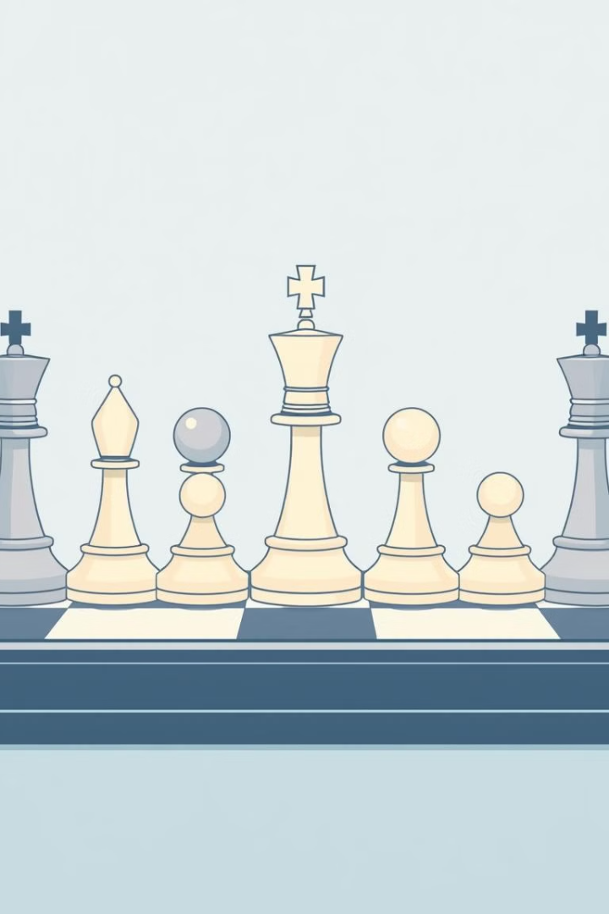




Structure: The Core Elements of the Game
Pawns
Knights
The most numerous and weakest pieces, but their movement and promotion potential make them crucial.
Unique L-shaped movement allows them to jump over other pieces and access key squares.
Bishops
Rooks
Powerful long-range diagonal movers that control important diagonals on the board.
Formidable linear movers that can exert control over files and ranks, especially in the endgame.

Slide 6
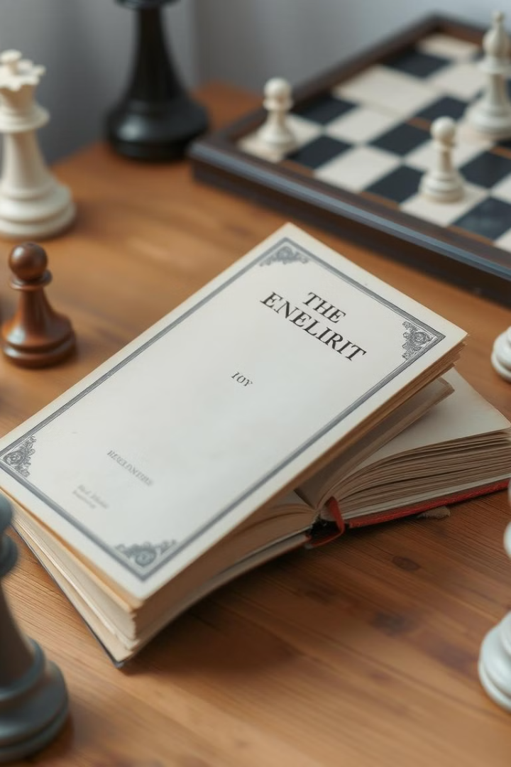
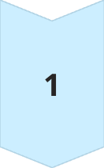
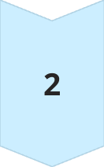
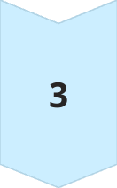
Literature Survey: Historical Perspectives and Modern Advancements
Ancient Origins
Chess traces its roots back to ancient civilizations in India, Persia, and the Middle East.
European Evolution
The game evolved and spread throughout Europe, with influential players and theorists shaping its development.
Modern Innovations
Computer analysis, opening theory, and coaching methodologies have revolutionized the way the game is played today.

Slide 7

Conclusion: The Lasting Impact of Chess on Society
Educational Tool
Cultural Significance
Unifying Force
Chess has been widely used as a tool for enhancing cognitive skills, critical thinking, and problem-solving in educational settings.
The game has transcended its recreational status, becoming a symbol of intellectual prowess and cultural identity.
Chess has the power to bring people together, fostering a global community of enthusiasts and promoting cross-cultural understanding.

Slide 8

References: Exploring Further Resources
Chess https://en.wikipedia.org/wiki/Chess
Chess.com https://en.wikipedia.org/wiki/Chess.com
Lichess https://en.wikipedia.org/wiki/Lichess
Stockfish (chess engine) https://en.wikipedia.org/wiki/Stockfish_(chess)
ChessBase https://en.wikipedia.org/wiki/ChessBase

